Slide 1
Predicting the NFL Game Winner
Group 1
Samuel aboma
Samuel Kuczynski
Felipe Serrano
vYtas stuopis

Slide 2
Agenda
Topic Discussion
Technologies Used
Questions we will be answering
Data Discussion
Model Discussion
Data Visualizations
Questions

Slide 3
Topic Discussion

Slide 4
Technologies Used

Slide 5
Questions we will be answering

Slide 6
Data Discussion

Slide 7
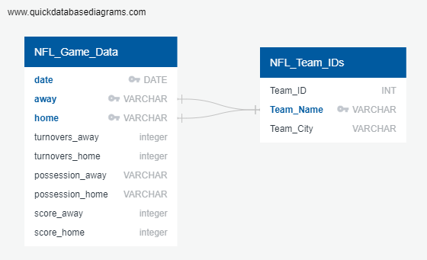
ERD DIAGRAM

Slide 8
Model Discussion

Slide 9
Was the model successful?

Slide 10
Other Models one could use?

Slide 11
Data Visualizations Used

Slide 12
Questions
?

